Slide 1
Double Irish with a Dutch Sandwich
Whitepaper Session
~Archit Mangrulkar

Slide 2
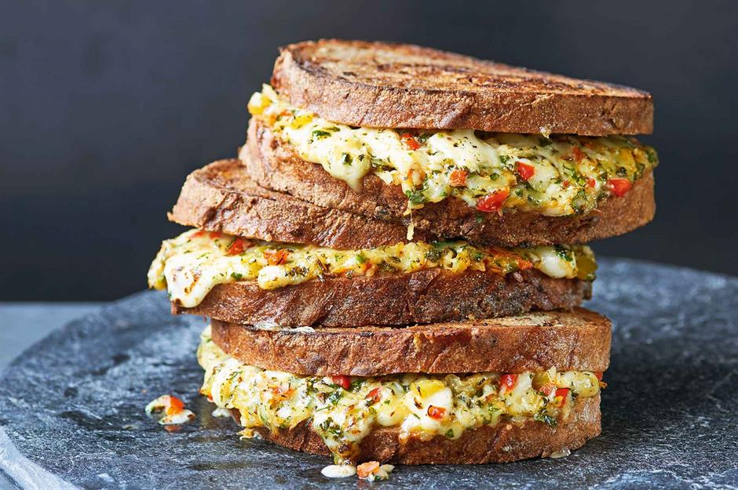

Slide 3
Some Figures
1 Trillion US Dollars gathered offshore by 2017
100 Billion dollars tax in Foreign profits saved
Apple’s 0.005% tax on European profits by 2014
US Corporate tax rate 35%

Slide 4
Double Irish with a Dutch Sandwich
BEPS- Base Erosion and Profit Shifting
Worldwide tax system in the USA

Slide 5
Two Tax systems
Worldwide system
Territorial system
Taxed on global income
Doubly taxed on Foreign profits
US used this till 2017
Taxed on territorial income
Promotes Free flow of cash
US after 2017, all G7 nations

Slide 6
Double Irish with a Dutch Sandwich
Apple US

Slide 7
Double Irish with a Dutch Sandwich
Apple US
1000 $ iPhone

Slide 8
Double Irish with a Dutch Sandwich
Apple US
1000 $ iPhone
350 $ tax

Slide 9
Double Irish with a Dutch Sandwich
Apple US
Apple EU Subsidiary
1000 $ iPhone
350 $ tax

Slide 10
Double Irish with a Dutch Sandwich
Apple US
Apple EU Subsidiary
1000 $ iPhone
1000 $ iPhone
Nation’s tax + 350 $ tax
350 $ tax

Slide 11
Double Irish with a Dutch Sandwich
Apple US
Caribbean islands subsidiary
Apple EU Subsidiary
(Irish)
1000 $ iPhone
1000 $ iPhone
0 $ tax
0 $ tax
350 $ tax

Slide 12
Double Irish with a Dutch Sandwich
DOESN’T WORK DUE TO CFC
Apple US
Caribbean islands subsidiary
Apple EU Subsidiary (Irish)
1000 $ iPhone
1000 $ iPhone
0 $ tax
Nation’s tax + 350 $ tax
350 $ tax

Slide 13
Controlled foreign corporations rule and workaround
CFC- entities in tax havens
CFC Rule- entity will be forced to pay tax in the us
Introduce another Irish company with control in Ireland itself

Slide 14
Double Irish with a Dutch Sandwich
Apple US
Caribbean islands subsidiary
Apple EU Subsidiary (Irish-B)
Apple EU Subsidiary (Irish-A)
Independent
Controlled in Caribbean islands
Control in Ireland
Independent
B pays full amount to Caribbean island subsidiary
A distributes and earns profits in European states
A makes full payment to B

Slide 15
Dutch Twist
Apple EU Subsidiary (Irish-A)
Apple EU Subsidiary (Irish-B)
Withholding tax
Dutch firm
No withholding tax
No withholding tax
Apple EU Subsidiary (Irish-A)
Apple EU Subsidiary (Irish-B)

Slide 16
Discovery & Shutdown
US discovered this in 2014, 5-year period for all tech firms
EU pressure to change Irish tax laws for avoiding BEPS
US switch to Territorial tax systems, Trump tax reforms
Apple’ s $252 billion cash repatriation plan

Slide 17
1. Single malt
Similar to Double Irish
Maltese/UAE firm replacing the Dutch sandwich
2018 amendment to the Ireland Malta tax treaty
By 2018, it made Ireland the largest global tax haven

Slide 18
2. CAIA
Capital allowances for intangible assets or Green jersey
More powerful than Double Irish Dutch sandwich and single malt
Based on providing capital allowances for intangible assets like IP
In q1 of 2015, apple booked $600 billion tax-free profit in Ireland

Slide 19
Apple’s Irish subsidiary
Apple’s Jersey subsidiary
Buys $300 Bil. IP
CAIA
Writes off this amount against future Irish profits
Apple doubles the tax shield to $600 Bil. with an ETR of 0%
Irish interest relief

Slide 20
Questions

